Slide 1
Modules

Slide 2
Module System
Initially, JavaScript has no built-in module system
Module system is supported through external libraries
Famous module system specification
CommonJS
AMD
Node.JS uses CommonJS module system.
Presently, ES6 has got built in module system (blend of CommonJS and AMD).
Notes:
Common JS - https://en.wikipedia.org/wiki/CommonJS
AMD - Require JS is AMD type module loader - http://requirejs.org/

Slide 3
Importing module
Loading dependencies
Use require();
var lodash = require(‘lodash’);
module will be searched locally at node_modules
require() call is synchronous

Slide 4
Creating Module
Create a .js file
Write all of your module code/logic
Expose the public API via “module.exports”.
export = module.exports = function myApi(){ …. }
Global object is also available.

Slide 5
Module definition patterns
Loading Dependencies
API Design
Information Hiding (public ,private)
Usability.
Named Exports
Exporting function
Exporting Constructors
Exporting Instance

Slide 6
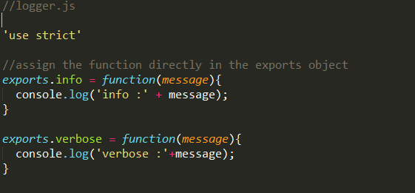
Named Exports
Basic method for exposing public API.
Most of Node.js core modules use this pattern.
Notes:
Path : <root_folder>/module_system/named_exports
File : logger.js , main.js

Slide 7
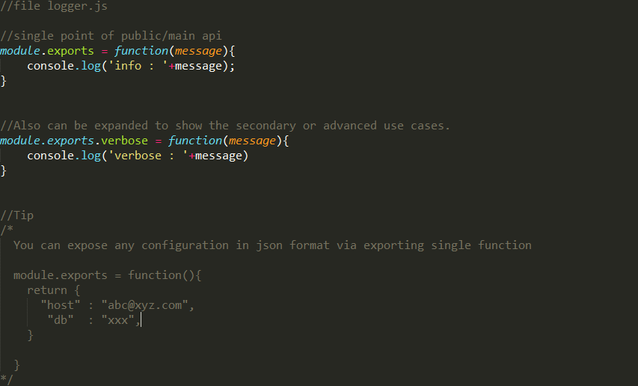
Exporting function
Assigning the whole module.exports to a function.
Main advantage : exposes single entry point.
Simple and easy to understand.

Slide 8
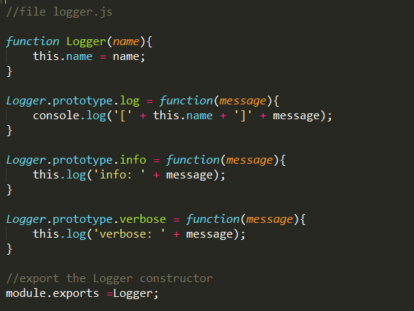
Exporting constructor

Slide 9
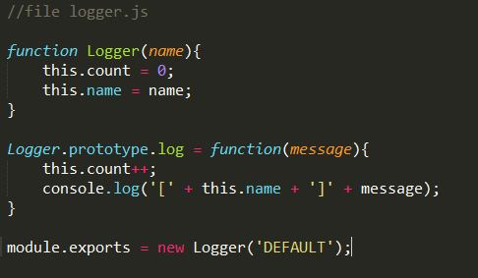
Exporting instance

